Slide 1
Teaching EAP in terms of academic mobility
British Council Ukraine “English for Universities” project
Dissemination event
Nataliia Nechai, Oksana Khazova

Slide 2
Who we are Who you are
Notes:
стикеры

Slide 3
What is EAP?

Slide 4
EAP – English for Academic Purposes –
the language and associated practices that people need in order to undertake study or work in English medium higher education
Andy Gillett
http://www.uefap.com/bgnd/whatfram.htm

Slide 5
For whom?
School leavers
Undergraduates
Master’s students
Postgraduates
Faculty members

Slide 6
Educational Culture
Conserving
Extending
reproductive
analytical
speculative
Memorisation & imitation
Deliberate search for new possibilities
Type
Critical thinking
Activities
Summarising
Describing
Identifying & applying formulae & information
Questioning, judging and recombining ideas and information into an argument
Speculating & hypothesising
How?
How valid?
How important?
What if?
Characteristic Question
What?
Why?
Aim
Simple
Originality
Reshaping material
Correctness
Creative originality
Ballard, B. and Clancy, J. (1991) Assessment by Misconception: Cultural influences and Intellectual traditions In Hamp-Lyons, L. (ed) Assessing Second Language Writing in Academic Contexts (1991) Westport: Ablex Publishing

Slide 7
Comparison of countries’ cultural aspects

Slide 8
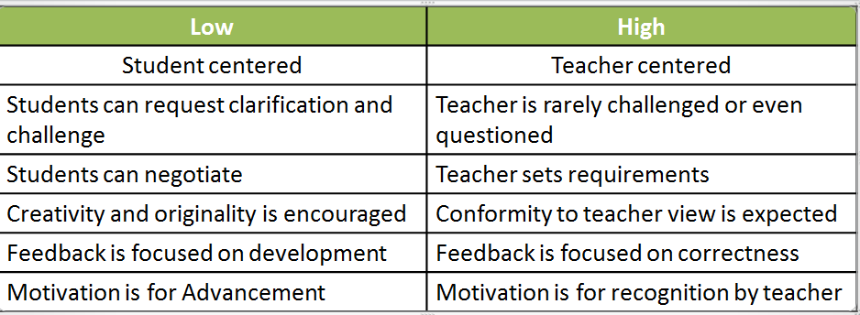
Power distance
UK USA Ukraine China

Slide 9
Collectivism vs Individualism
Collectivist
Individualist
Societies in which from birth onwards people are integrated into strong, cohesive in-groups, which throughout people’s lifetimes continue to protect them in exchange for unquestioning loyalty.’
‘Societies in which the ties between individuals are loose: everyone expected to look after him or herself and his or her immediate family.’

Slide 10
Features of Academic English style Complexity Formality Precision Objectivity Explicitness Accuracy Hedging Responsibility

Slide 11
Formality
Complexity
Formality
Precision
Objectivity
Formality
Non colloquial
Noun based
Exact measure
Avoid bias
UEfAP
University English for Academic Purposes
Andy Gillet
No contractions
Subordinated
Indicate priority
Evaluate evidence
Passive
Emphasise info
Lexically dense
No refer writer
Lexically varied
Explicitness
Hedging
Responsibility
Accuracy
State purpose / POV
Text relationship
Evaluate position
Justify position
Exact meaning
Specific relationship
Evaluate evidence
Provide evidence
Exact word form
Avoid ambiguity
Show other POV
Explain material
Field specific

Slide 12
IELTS
Noun Based
Passive voice
Tense & Aspect
Modality
60% of all content
25% of all verb use
70% Present 15% Past
15% of all verb forms
Premodified (Adjective / noun)
Common verbs incl – made / given
94% simple aspect
Cohesion
6% perfective
2% progressive
Anaphoric
Specific Adverbs
Limited pronouns (this, that, these, those)
Postmodified
(relative clause)
Short form (without by) common

Slide 13
Thank you for cooperation!

